Slide 1
Women of the Faculty of Advocates
Remembering Margaret Kidd 1923 to 2023
Margaret Kidd Centenary
Notes:
Line spacing + Page numbers

Slide 2
Women of the Faculty of Advocates
Remembering Margaret Kidd 1923 to 2023
Notes:
Line spacing + Page numbers

Slide 3
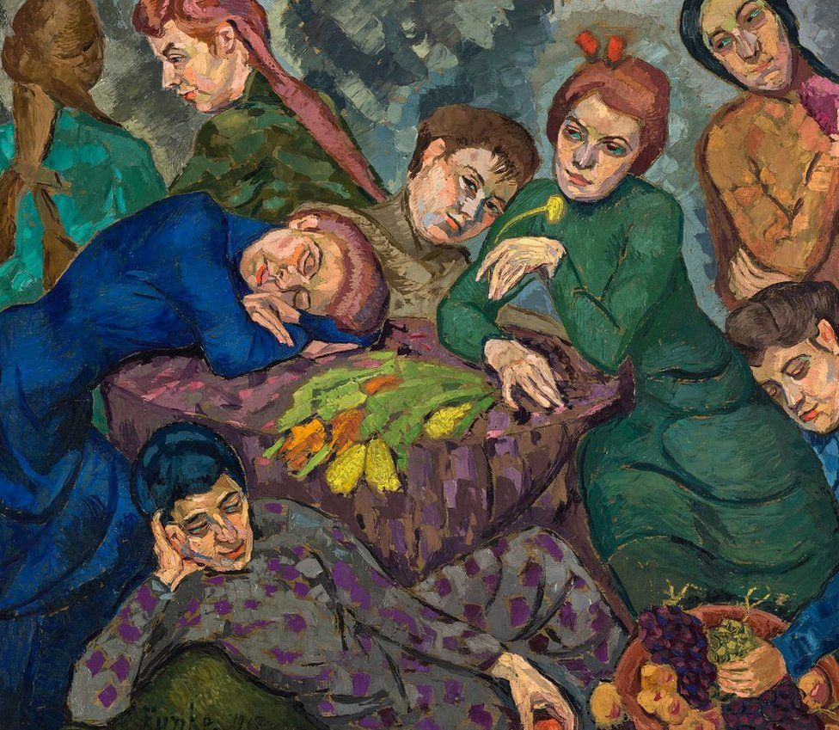
Women Dreaming

Slide 4
Women Dreaming
~Dreams by Helene Funke, 1913 oil on canvas

Slide 5
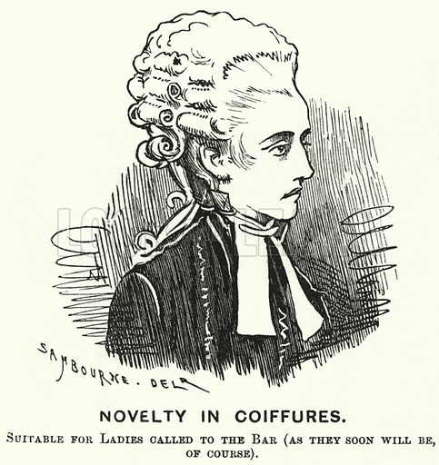
Sex Disqualification (Removal) Act 1919
Punch, Volume 68, January – June 1875 ~

Slide 6
Sex Disqualification (Removal) Act 1919
Following the Representation of the People Act 1918, giving some women the right to vote, the Sex Disqualification (Removal) Act 1919 opened the legal profession to women for the first time.

Slide 7
Sex Disqualification (Removal) Act 1919
Following the Representation of the People Act 1918, giving some women the right to vote, the Sex Disqualification (Removal) Act 1919 opened the legal profession to women for the first time.
In 1919, The Scotsman reported that a representative member “declared the feeling of the Faculty [of Advocates] to be that, although they did not think women suited for the work, there was no use protesting [the Bill] at this time of day…”

Slide 8
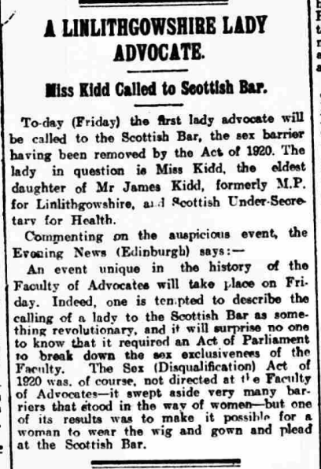
The first woman advocate…

Slide 9
The first woman advocate…
“To day… the first lady advocate will be called to the Scottish Bar, the sex barrier having been removed by the Act of 1920. The lady in question is Miss Kidd...”
Linlithgowshire Gazette, Friday 13th July 1923 ~

Slide 10
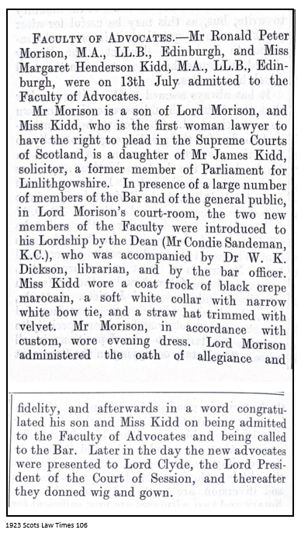
The first woman advocate…

Slide 11
The first woman advocate…
“…Miss Margaret Kidd, MA., LL.B., Edinburgh, [was] on 13th July admitted to the Faculty of Advocates… Miss Kidd… is the first woman lawyer to have the right to plead in the Supreme Courts of Scotland…

Slide 12
The first woman advocate…
“…Miss Margaret Kidd, MA., LL.B., Edinburgh, [was] on 13th July admitted to the Faculty of Advocates… Miss Kidd… is the first woman lawyer to have the right to plead in the Supreme Courts of Scotland…
…Miss Kidd wore a coat frock of black crepe marocain, a soft white collar with narrow white bow tie, and a straw hat trimmed with velvet. Mr Morison, in accordance with custom, wore evening dress…” ~ 1923 Scots Law Times 106

Slide 13
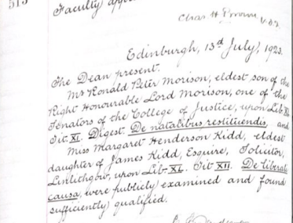
The first woman advocate…

Slide 14
The first woman advocate…
“…publicly examined and found sufficiently qualified”
~ Faculty Minute Book, 13th July 1923

Slide 15
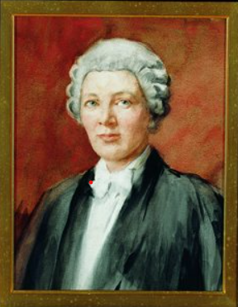
The first woman advocate…

Slide 16
The first woman advocate…
Dame Margaret Kidd Date and Artist: Unknown
Watercolour

Slide 17
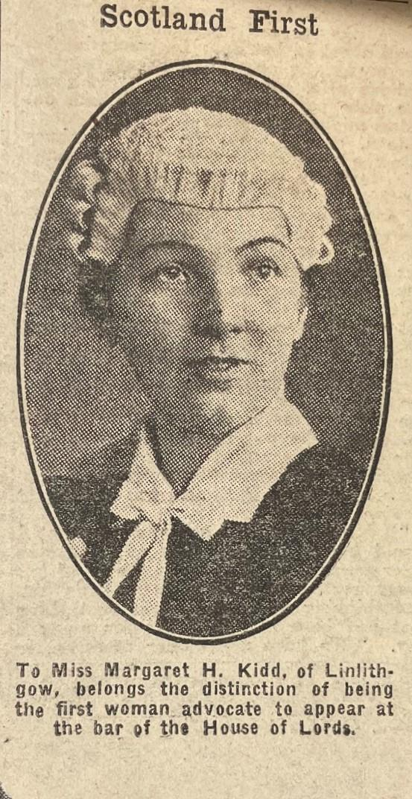
First female counsel before the House of Lords

Slide 18
First female counsel before the House of Lords
“The appeal was of exceptional interest, not only in that it raised a question of Scottish legal procedure, but also from the fact that Scotland’s first woman advocate, and the first woman barrister of any Bar to appear in the House of Lords – Miss Margaret H Kidd – was briefed in it on behalf of the appellant”
~ Glasgow Herald, 12 June 1926, p.7

Slide 19
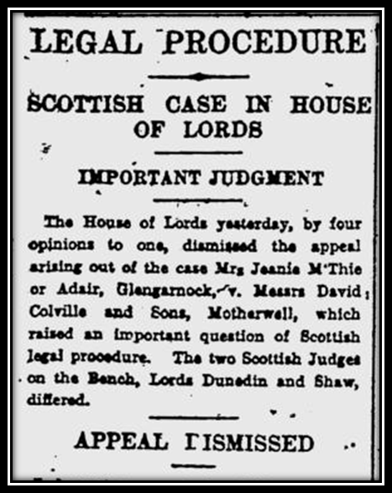
First female counsel to appear before the House of Lords
“The appeal was of exceptional interest, not only in that it raised a question of Scottish legal procedure, but also from the fact that Scotland’s first woman advocate, and the first woman barrister of any Bar to appear in the House of Lords – Miss Margaret H Kidd – was briefed in it on behalf of the appellant”
~ Glasgow Herald, 12 June 1926, p.7

Slide 20
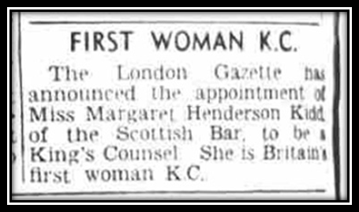
Margaret Kidd, K.C.

Slide 21
Margaret Kidd, K.C.
In 1948, Margaret Kidd was appointed the UK’s first female King’s Counsel, the year before the first two female K.Cs were appointed to the English bar.

Slide 22
Margaret Kidd, K.C.
In 1948, Margaret Kidd was appointed the UK’s first female King’s Counsel, the year before the first two female K.Cs were appointed to the English bar.
Frances Moran had been appointed Senior Counsel to the Irish bar in 1941.

Slide 23
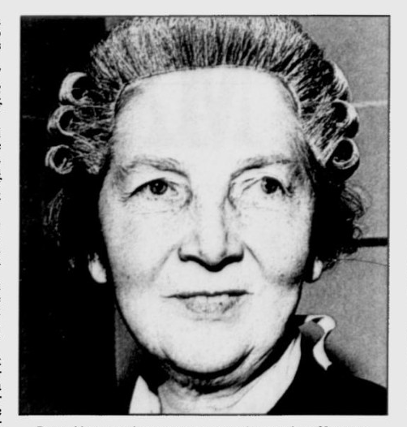
Keeper of the Advocates Library

Slide 24
Keeper of the Advocates Library
For 13 years (from 1956 to 1969), Margaret Kidd served as Keeper of the Advocates Library. As such, she was the first female Office Bearer within the Faculty

Slide 25
Keeper of the Advocates Library
For 13 years (from 1956 to 1969), Margaret Kidd served as Keeper of the Advocates Library. As such, she was the first female Office Bearer within the Faculty
She remained the only female office bearer until Valerie Stacey QC became Vice-Dean in 2004

Slide 26
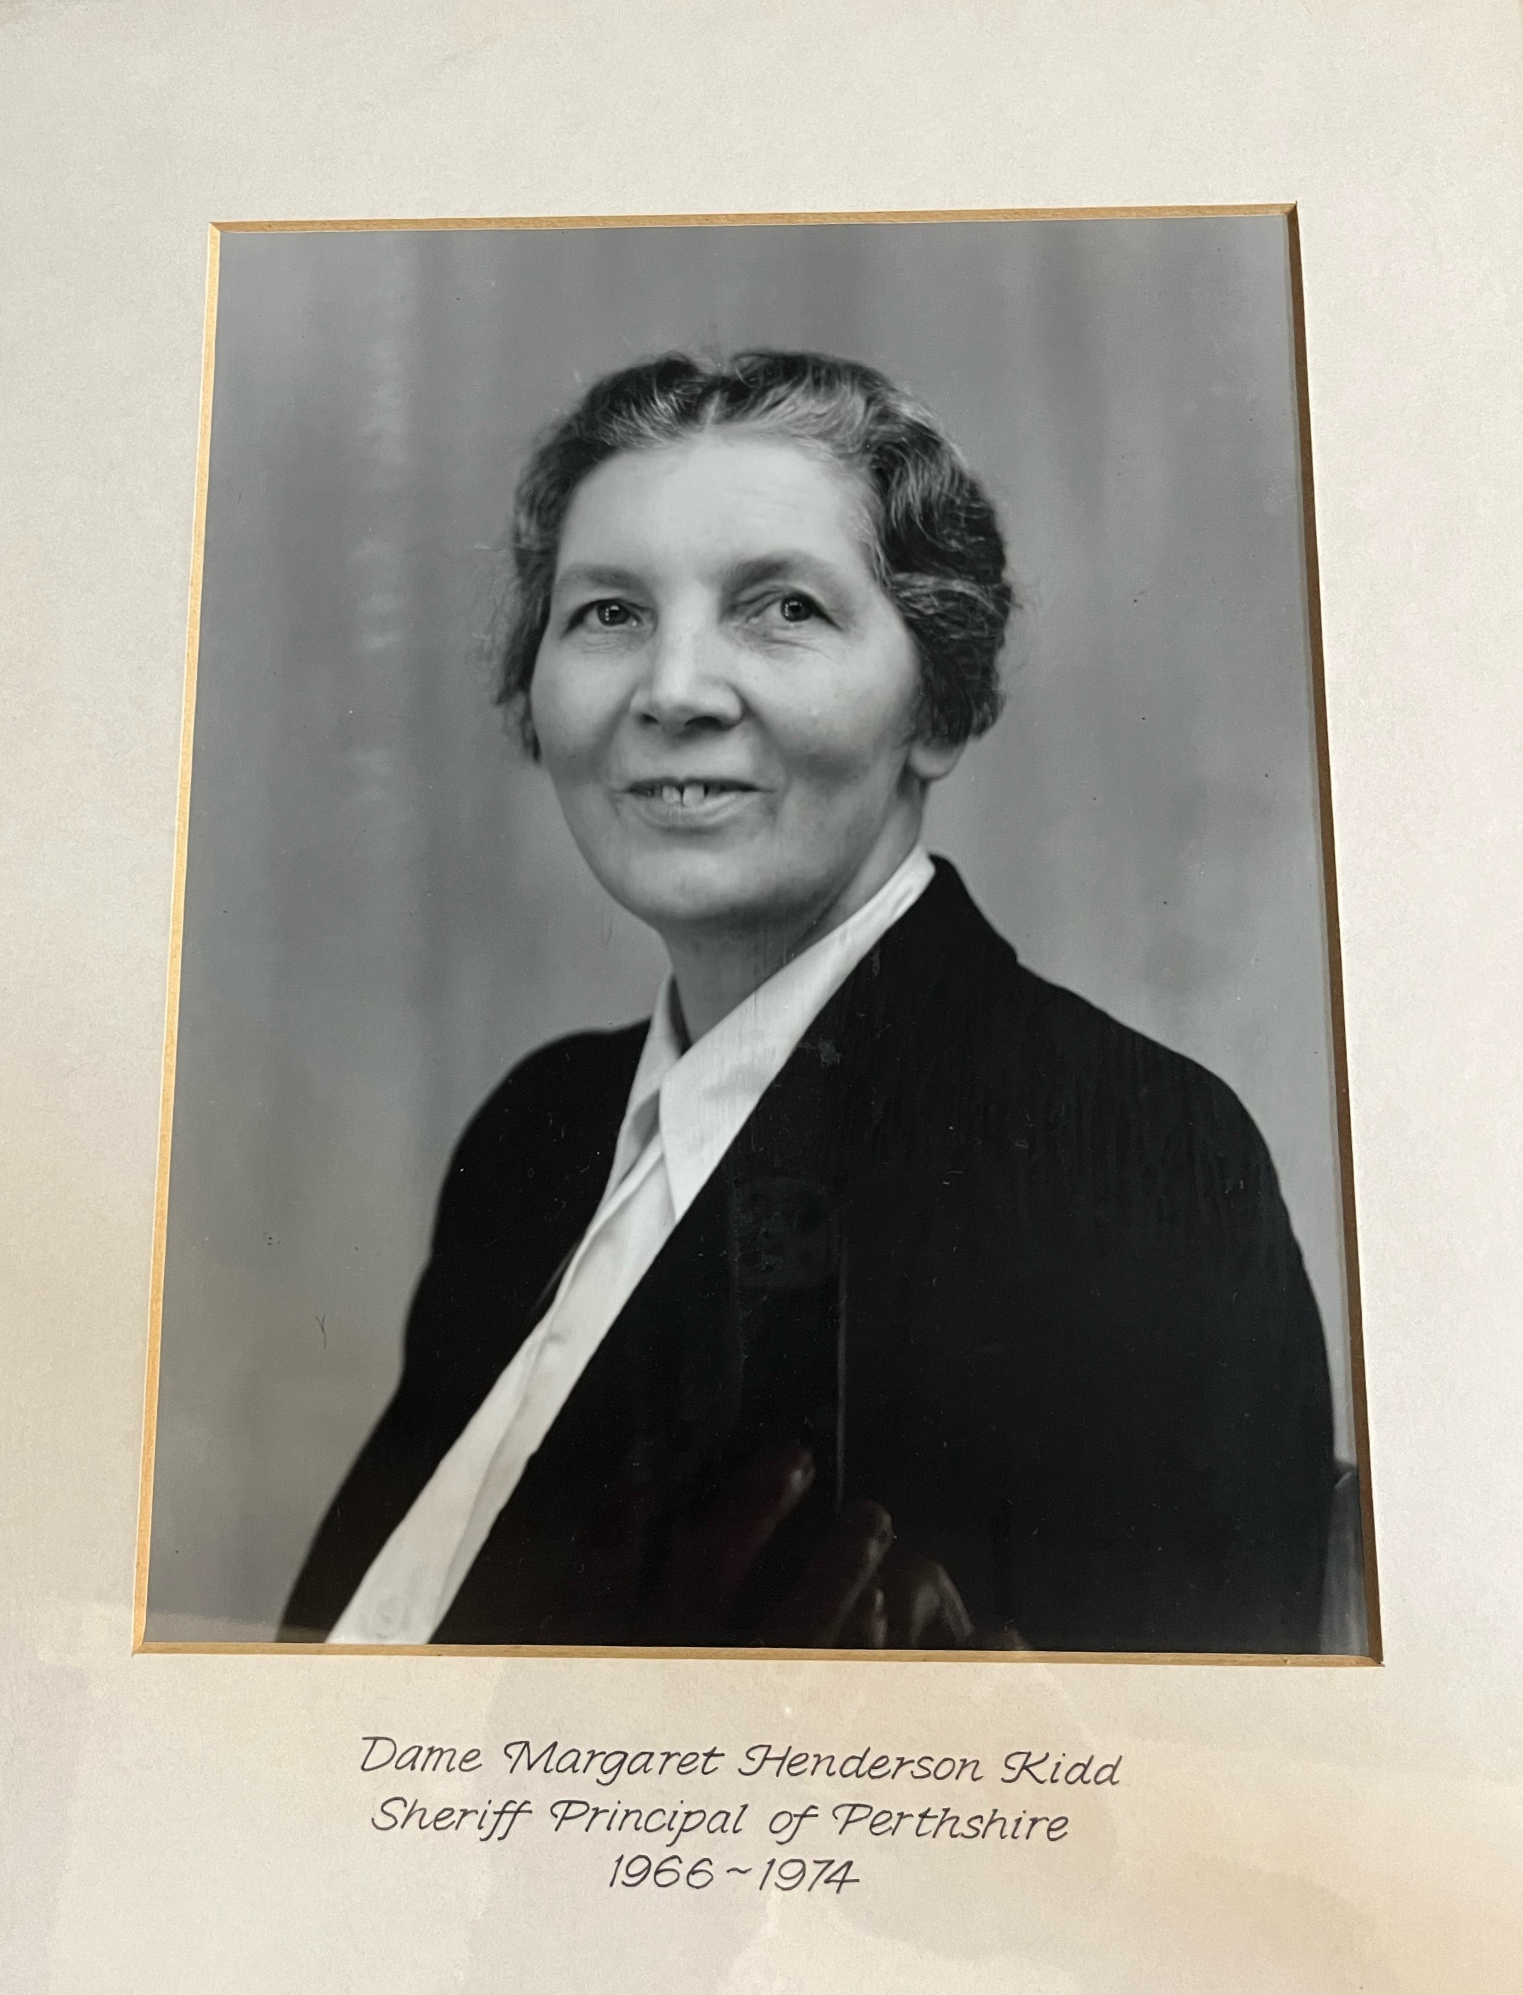
Sheriff Principal

Slide 27
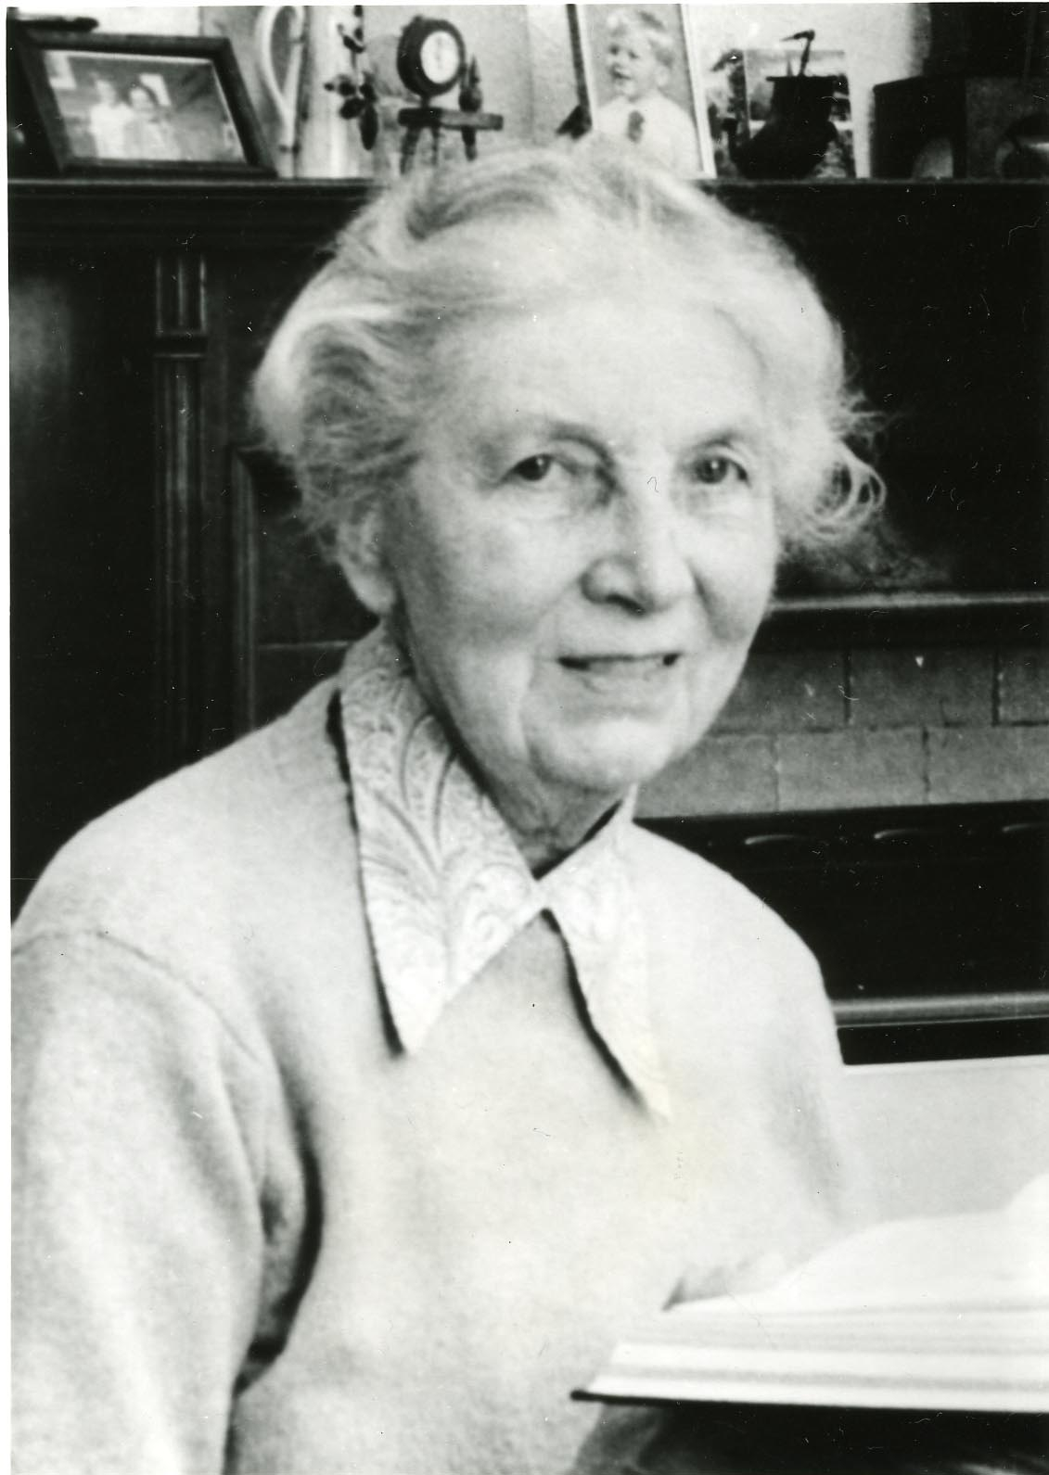

Slide 29
Women of the Faculty of Advocates
1923 ~ Margaret Kidd

Slide 30
Women of the Faculty of Advocates
1923 ~ Margaret Kidd
1949 ~ Isabel Sinclair Margaret Macintyre

Slide 31
Women of the Faculty of Advocates
1923 ~ Margaret Kidd
1949 ~ Isabel Sinclair Margaret Macintyre
by 1963 Joan Smith Anne McCall-Smith Ailie Clark Hutchison Margaret Christie Caroline McNaughton Agnes Dickie

Slide 32
Women of the Faculty of Advocates
1923 ~ Margaret Kidd
1949 ~ Isabel Sinclair Margaret Macintyre
by 1963 ~ Joan Smith Anne McCall-Smith Ailie Clark Hutchison Margaret Christie Caroline McNaughton Agnes Dickie
by 1983 Isobel Poole Hazel Cosgrove Rosaleen Morrison Ann Inglis Jean Forsyth Jennifer Taylor Laura Anne Duncan Lynda Clark Ann Paton Susan Raeburn Anne Smith Pamela Clough Leeona Dorrian Elizabeth Jarvie Gail Patrick Dierdre MacNeill Anne McIntosh Rita Rae Helen Askam Fiona Reith Michele Keklak Eirlys M.S. Smith

Slide 33
Women of the Faculty of Advocates
1923 ~ Margaret Kidd
1949 ~ Isabel Sinclair Margaret Macintyre
by 1963 ~ Joan Smith Anne McCall-Smith Ailie Clark Hutchison Margaret Christie Caroline McNaughton Agnes Dickie
by 1983 ~ Isobel Poole Hazel Cosgrove Rosaleen Morrison Ann Inglis Jean Forsyth Jennifer Taylor Laura Anne Duncan Lynda Clark Ann Paton Susan Raeburn Anne Smith Pamela Clough Leeona Dorrian Elizabeth Jarvie Gail Patrick Dierdre MacNeill Anne McIntosh Rita Rae Helen Askam Fiona Reith Michele Keklak Eirlys M.S. Smith
by 2003 Ruth Anderson Frances McMenamin Marion Caldwell Mary Ralston Maria Clarke Christian McNeill Maria Maguire Annella Cowan Margaret Porter Valerie Stacey Nikola Stewart Gillian Gibson Susan O'Brien Khadiga Strang J.A. Seymour Lucy Keane Mhairi Richards Joyce Powrie Susan Sinclair Laura Dunlop Gail Joughin Eileen Davie Anne McGavin Lesley Shand Mary Sharpe Sherren Smith Lindsey Stewart Roseanna Cunningham Margaret Hughes Dinah Illius Margaret Scott Ruth Anderson Jane Paterson Charlotte Coutts Marian Gilmore Janys Scott Johanna Johnston Isabel Walker Isobel Wylie Ruth Crawford Isabella Ennis Louise Milligan Ailsa Wilson Ailsa Carmichael June Gilchrist Morag Wise Helen Bishop Fiona Davies Isobel McColl Jacqueline Wise Rosemary Guinnane Dorothy Bain Jane Patrick Jane Porter Celia Sanderson Sarah Wolffe Lesley-Anne Williamson Kate Phillips Angela Grahame Lisa Henderson Arabella Tait Victoria Young Morag Armstrong Joanna Cherry Marie Smart Gillian Peebles Marie Clark Lauren Sutherland Shona Haldane Margaret Hodge Alison Stirling Pauline Thornton Jacqueline Williamson Petra Collins Lorna Drummond Amanda Lothian Anna Poole Gillian Wade Deborah Carter Catriona Maclean Elizabeth McLaughlin Una Doherty Sarah Livingstone Jan McCall Astrid Smart Kay Springham Moira MacKenzie Ashley Edwards Roisin Higgins Luise Locke Shelagh McCall Susanne Tanner Ruth Charteris Kate Dowdalls Morag Jack Patricia Comiskey Gail Gianni Kirsty Hood Cecilia Dyckhoff Jo Edwardson Sheena Stark Jennifer Bain Frances Connor Fiona Drysdale Paula Collar Jane Farquharson Linda Marsh Leigh Mason Almira Delibegovic-Broome Katariina Maguire Claire Mitchell Morag Ross Laura Wray Margaret Breslin Susan Duff Sheena Fraser Nancy Reville

Slide 34
Women of the Faculty of Advocates
1923 ~ Margaret Kidd
1949 ~ Isabel Sinclair Margaret Macintyre
by 1963 ~ Joan Smith Anne McCall-Smith Ailie Clark Hutchison Margaret Christie Caroline McNaughton Agnes Dickie
by 1983 ~ Isobel Poole Hazel Cosgrove Rosaleen Morrison Ann Inglis Jean Forsyth Jennifer Taylor Laura Anne Duncan Lynda Clark Ann Paton Susan Raeburn Anne Smith Pamela Clough Leeona Dorrian Elizabeth Jarvie Gail Patrick Dierdre MacNeill Anne McIntosh Rita Rae Helen Askam Fiona Reith Michele Keklak Eirlys M.S. Smith
by 2003 ~ Ruth Anderson Frances McMenamin Marion Caldwell Mary Ralston Maria Clarke Christian McNeill Maria Maguire Annella Cowan Margaret Porter Valerie Stacey Nikola Stewart Gillian Gibson Susan O'Brien Khadiga Strang J.A. Seymour Lucy Keane Mhairi Richards Joyce Powrie Susan Sinclair Laura Dunlop Gail Joughin Eileen Davie Anne McGavin Lesley Shand Mary Sharpe Sherren Smith Lindsey Stewart Roseanna Cunningham Margaret Hughes Dinah Illius Margaret Scott Ruth Anderson Jane Paterson Charlotte Coutts Marian Gilmore Janys Scott Johanna Johnston Isabel Walker Isobel Wylie Ruth Crawford Isabella Ennis Louise Milligan Ailsa Wilson Ailsa Carmichael June Gilchrist Morag Wise Helen Bishop Fiona Davies Isobel McColl Jacqueline Wise Rosemary Guinnane Dorothy Bain Jane Patrick Jane Porter Celia Sanderson Sarah Wolffe Lesley-Anne Williamson Kate Phillips Angela Grahame Lisa Henderson Arabella Tait Victoria Young Morag Armstrong Joanna Cherry Marie Smart Gillian Peebles Marie Clark Lauren Sutherland Shona Haldane Margaret Hodge Alison Stirling Pauline Thornton Jacqueline Williamson Petra Collins Lorna Drummond Amanda Lothian Anna Poole Gillian Wade Deborah Carter Catriona Maclean Elizabeth McLaughlin Una Doherty Sarah Livingstone Jan McCall Astrid Smart Kay Springham Moira MacKenzie Ashley Edwards Roisin Higgins Luise Locke Shelagh McCall Susanne Tanner Ruth Charteris Kate Dowdalls Morag Jack Patricia Comiskey Gail Gianni Kirsty Hood Cecilia Dyckhoff Jo Edwardson Sheena Stark Jennifer Bain Frances Connor Fiona Drysdale Paula Collar Jane Farquharson Linda Marsh Leigh Mason Almira Delibegovic-Broome Katariina Maguire Claire Mitchell Morag Ross Laura Wray Margaret Breslin Susan Duff Sheena Fraser Nancy Reville by 2023 Isla Davie Karen Bruce Lockhart Heather-Mairi Carmichael Lorna Maclean Isabelle McKerrow Alice Taggart Louise Arrol Lynda Brabender Amber Galbraith Lisa Gillespie Lorraine Glancy Ruth Innes Shirley McKenna Piya Muqit Jane Munro Margaret Barron Juliette Casey Caroline MacBride Yvonne Waugh Catherine Devaney Laura Reilly Helen Wright Edith Forrest Miranda Hamilton Catriona MacLeod Kirsty Malcolm Catherine Smith Alice Stobart Jeya Irvine Catherine MacColl Lynsey MacDonald Alison Wild Elish Angiolini Linda Pike Janice Green Susan Ower Gillian Ross Emma Toner Laura-Anne Van Der Westhuizen Helen Watts Emma Peters Leigh Lawrie Lili Prais Maryam Labaki Jillian Martin-Brown Julianna Cartwright Nicola Gilchrist Alexandra Price-Marmion Claire Thomas Kelly Duling Lesley Irvine Ceit-Anna MacLeod Clare Connelly Wendy Culross Victoria Dow Margaret McFarlane Julie McKinlay Jennifer Nicholson-White Elisabeth Roxburgh Katerina Stein Ximena Vengoechea Gail Hawthorne Di Moore Safeena Rashid Donna Armstrong Kate Bennett Alyson Forbes Rachel Shewan Laura Thomson Kathryn Pickard Mhairi Stephen Faryma Bahrami Anne Bennie Dana Forbes Jane Rattray Susan Craig Jacqueline Fordyce Jane McMillan Kirsty Tyre Amy Donachie Ann MacNeill Tracey Brown Megan Dewart Victoria Arnott Melanie Barbour Carla Fraser Valentina Mori Laura Anne Radcliffe Elaine Russell Antonia Welsh Patricia Baillie Emily Bradbury Susan Fallone Catriona MacQueen Rosalyn McTaggart Mary Ellen Stewart Sarah Trainer Jordanna Blockley Emma Boffey Sheana Campbell Louise Cockburn Megan Davidson Ayla Iridag Sarah Loosemore Lynsey Morgan Katharine Muir Elaine Smith

Slide 35
Women of the Faculty of Advocates
Total number of women called since 1923: 255

Slide 36
Women of the Faculty of Advocates
Total number of women called since 1923: 255
Number of practising female Advocates in 2023: 121

Slide 37
Women of the Faculty of Advocates
Total number of women called since 1923: 255
Number of practising female Advocates in 2023: 121
Percentage of total practising membership: 28%

Slide 38
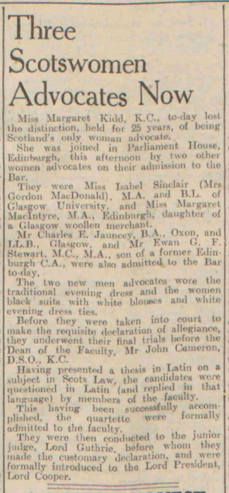
The second woman advocate…

Slide 39
The second woman advocate…
“Miss Margaret Kidd, K.C., to-day lost the distinction, held for 25 years, of being Scotland's only woman advocate. She was joined… this afternoon by two other women advocates on their admission to the Bar.

Slide 40
The second woman advocate…
“Miss Margaret Kidd, K.C., to-day lost the distinction, held for 25 years, of being Scotland's only woman advocate. She was joined… this afternoon by two other women advocates on their admission to the Bar.
They were Miss Isabel Sinclair… and Miss Margaret MacIntyre…”
~ Dundee Evening Telegraph, Friday 15 July 1949

Slide 41
The second woman advocate…
“[Isabel Sinclair…was] determined to assert her rights to all the social aspects of the Parliament House. She turned over new ground like a plough and like a plough she turned up many worms. Isabel Sinclair was a vital young woman in that den of elderly men of all ages she was regarded with consternation”
~ Ian Hamilton QC, A Touch of Treason

Slide 42
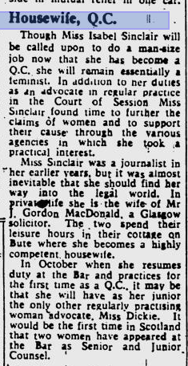
The second woman advocate…

Slide 43
The second woman advocate…
“Though Miss Isabel Sinclair will be called upon to do a man-size job now that she has become a Q.C. she will remail essentially a feminist.
~Glasgow Herald, 29 July 1964, p.6

Slide 44
The second woman advocate…
“Though Miss Isabel Sinclair will be called upon to do a man-size job now that she has become a Q.C. she will remail essentially a feminist. In addition to her duties as an advocate in regular practice in the Court of Session Miss Sinclair found time to further the claims of women and to support their cause through the various agencies in which she took a practical interest.
~Glasgow Herald, 29 July 1964, p.6

Slide 45
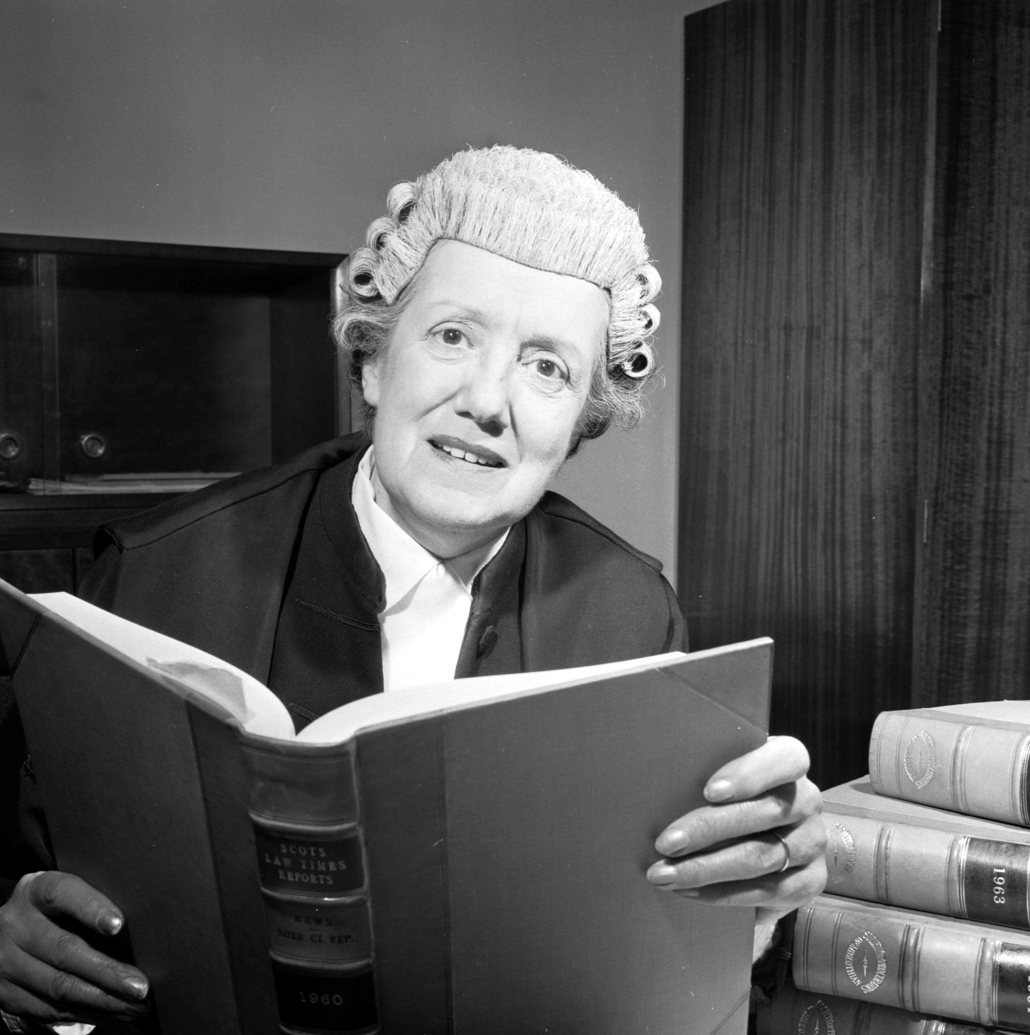
The second woman advocate…

Slide 46
The second woman advocate…
Despite the lonely path she trod as a woman lawyer in the 1950s -1970s, a confident [Isabel Sinclair] would not be put in her place in such a male-dominated profession… giving something of the flavour of this incredible woman, when requested by the Dean of the Faculty of Advocates to remove her red nail varnish, which he considered unsuitable for dress in court, she responded by suggesting he remove his side-whiskers…
~ 100 Voices for 100 Years, Glasgow University , School of Law

Slide 47
The second woman advocate…
Despite the lonely path she trod as a woman lawyer in the 1950s -1970s, a confident [Isabel Sinclair] would not be put in her place in such a male-dominated profession… giving something of the flavour of this incredible woman, when requested by the Dean of the Faculty of Advocates to remove her red nail varnish, which he considered unsuitable for dress in court, she responded by suggesting he remove his side-whiskers…
The nail varnish remained.
~ 100 Voices for 100 Years, Glasgow University , School of Law

Slide 48
The first female Senator of the College of Justice

Slide 49
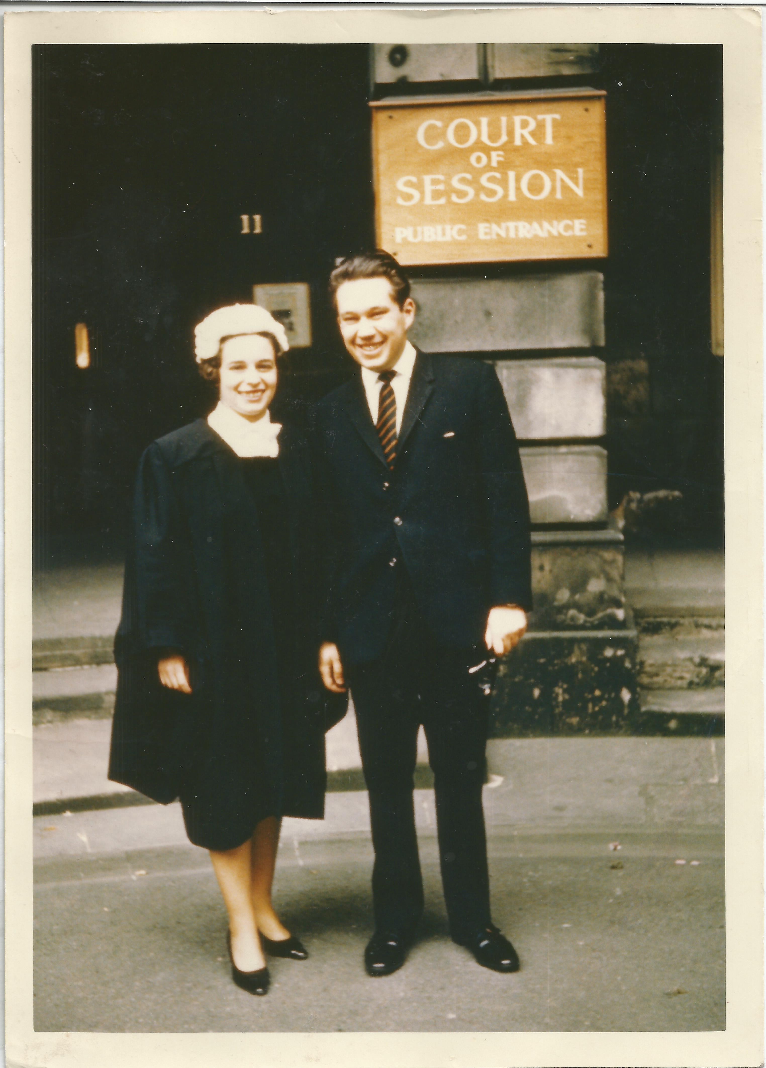
The first female Senator of the College of Justice
Hazel Cosgrove on her calling day, 7th June 1968

Slide 50
The first female Senator of the College of Justice
Hazel Cosgrove was admitted to the Faculty of Advocates in 1968.

Slide 51
The first female Senator of the College of Justice
Hazel Cosgrove was admitted to the Faculty of Advocates in 1968.
She was the first woman appointed a full-time sheriff at Glasgow and was later a sheriff at Edinburgh

Slide 52
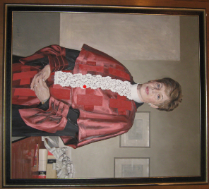
The first female Senator of the College of Justice

Slide 53
The first female Senator of the College of Justice
The RT. Hon. Lady Cosgrove by David Reid, 2006
Oil Painting

Slide 54
The first female Senator of the College of Justice
Lady Cosgrove was appointed a Senator of the College of Justice on 12 July 1996.
The RT. Hon. Lady Cosgrove by David Reid, 2006
Oil Painting

Slide 55
The first female Senator of the College of Justice

Slide 56
Women of the Faculty of Advocates, 1923 to 2023
Margaret Kidd Isabel Sinclair Margaret Macintyre Joan Smith Anne McCall-Smith Ailie Clark Hutchison Margaret Christie Caroline McNaughton Agnes Dickie Isobel Poole Hazel Cosgrove Rosaleen Morrison Ann Inglis Jean Forsyth Jennifer Taylor Laura Anne Duncan Lynda Clark Ann Paton Susan Raeburn Anne Smith Pamela Clough Leeona Dorrian Elizabeth Jarvie Gail Patrick Dierdre MacNeill Anne McIntosh Rita Rae Helen Askam Fiona Reith Michele Keklak Eirlys M.S. Smith Ruth Anderson Frances McMenamin Marion Caldwell Mary Ralston Maria Clarke Christian McNeill Maria Maguire Annella Cowan Margaret Porter Valerie Stacey Nikola Stewart Gillian Gibson Susan O'Brien Khadiga Strang J.A. Seymour Lucy Keane Mhairi Richards Joyce Powrie Susan Sinclair Laura Dunlop Gail Joughin Eileen Davie Anne McGavin Lesley Shand Mary Sharpe Sherren Smith Lindsey Stewart Roseanna Cunningham Margaret Hughes Dinah Illius Margaret Scott Ruth Anderson Jane Paterson Charlotte Coutts Marian Gilmore Janys Scott Johanna Johnston Isabel Walker Isobel Wylie Ruth Crawford Isabella Ennis Louise Milligan Ailsa Wilson Ailsa Carmichael June Gilchrist Morag Wise Helen Bishop Fiona Davies Isobel McColl Jacqueline Wise Rosemary Guinnane Dorothy Bain Jane Patrick Jane Porter Celia Sanderson Sarah Wolffe Lesley-Anne Williamson Kate Phillips Angela Grahame Lisa Henderson Arabella Tait Victoria Young Morag Armstrong Joanna Cherry Marie Smart Gillian Peebles Marie Clark Lauren Sutherland Shona Haldane Margaret Hodge Alison Stirling Pauline Thornton Jacqueline Williamson Petra Collins Lorna Drummond Amanda Lothian Anna Poole Gillian Wade Deborah Carter Catriona Maclean Elizabeth McLaughlin Una Doherty Sarah Livingstone Jan McCall Astrid Smart Kay Springham Moira MacKenzie Ashley Edwards Roisin Higgins Luise Locke Shelagh McCall Susanne Tanner Ruth Charteris Kate Dowdalls Morag Jack Patricia Comiskey Gail Gianni Kirsty Hood Cecilia Dyckhoff Jo Edwardson Sheena Stark Jennifer Bain Frances Connor Fiona Drysdale Paula Collar Jane Farquharson Linda Marsh Leigh Mason Almira Delibegovic-Broome Katarina Maguire Claire Mitchell Morag Ross Laura Wray Margaret Breslin Susan Duff Sheena Fraser Nancy Reville Isla Davie Karen Bruce Lockhart Heather-Mairi Carmichael Lorna Maclean Isabelle McKerrow Alice Taggart Louise Arrol Lynda Brabender Amber Galbraith Lisa Gillespie Lorraine Glancy Ruth Innes Shirley McKenna Piya Muqit Jane Munro Margaret Barron Juliette Casey Caroline MacBride Yvonne Waugh Catherine Devaney Laura Reilly Helen Wright Edith Forrest Miranda Hamilton Catriona MacLeod Kirsty Malcolm Catherine Smith Alice Stobart Jeya Irvine Catherine MacColl Lynsey MacDonald Alison Wild Elish Angiolini Linda Pike Janice Green Susan Ower Gillian Ross Emma Toner Laura-Anne Van Der Westhuizen Helen Watts Emma Peters Leigh Lawrie Lili Prais Maryam Labaki Jillian Martin-Brown Julianna Cartwright Nicola Gilchrist Alexandra Price-Marmion Claire Thomas Kelly Duling Lesley Irvine Ceit-Anna MacLeod Clare Connelly Wendy Culross Victoria Dow Margaret McFarlane Julie McKinlay Jennifer Nicholson-White Elisabeth Roxburgh Katerina Stein Ximena Vengoechea Gail Hawthorne Di Moore Safeena Rashid Donna Armstrong Kate Bennett Alyson Forbes Rachel Shewan Laura Thomson Kathryn Pickard Mhairi Stephen Faryma Bahrami Anne Bennie Dana Forbes Jane Rattray Susan Craig Jacqueline Fordyce Jane McMillan Kirsty Tyre Amy Donachie Ann MacNeill Tracey Brown Megan Dewart Victoria Arnott Melanie Barbour Carla Fraser Valentina Mori Laura Anne Radcliffe Elaine Russell Antonia Welsh Patricia Baillie Emily Bradbury Susan Fallone Catriona MacQueen Rosalyn McTaggart Mary Ellen Stewart Sarah Trainer Jordanna Blockley Emma Boffey Sheana Campbell Louise Cockburn Megan Davidson Ayla Iridag Sarah Loosemore Lynsey Morgan Katharine Muir Elaine Smith

Slide 57
Sources and citations
Dreams by Helene Funke, 1913 (oil on canvas) JOHANNES STOLL/BELVEDERE
Novelty in Coiffures. Illustration for Punch, Volume 68, January – June 1875, After Edward Linley Sambourne
Sex Disqualification Bill: views of the legal profession, The Scotsman, 28 November 1919 (Newspaper Cuttings, 1917-1921, p.103. Faculty Archives.)
Glasgow Herald, 29 June 1923: https://news.google.com/newspapers?id=ipdAAAAAIBAJ&pg=3497%2C7826255
Hartlepool Northern Daily Mail, 28 December 1948. Image copyright: The British Newspaper Archive
Ian Hamilton QC, A Touch of Treason, chapter 7
Glasgow Herald, 12 June 1926, p.7
Scotland's History: Dame Margaret Henderson Kidd QC | ScotlandsPeople
100 Voices for 100 Years, https://www.gla.ac.uk/schools/law/100years/100voices/
The Bulletin, 27 Jun 1956, p.11
Glasgow Herald. 27 March 1989, p.16
Dundee Evening Telegraph, Friday 15 July, 1949
The Rt Hon Lady Hazel Cosgrove CBE, https://www.saltiresociety.org.uk
Margaret Kidd Centenary

Slide 58
Proceeds and donations from this evening will go to support:
The Lawscot Foundation aims to support academically talented students from less-advantaged backgrounds in Scotland through their legal education journey.
www.lawscotfoundation.org.uk
Womankind Worldwide strengthens and supports women’s rights organisations and movements with the resources they need to challenge oppression and change the lives of women, in the home, the workplace and the communities they live in.
www.womankind.org.uk

Slide 59
Edinburgh 1923
Margaret Kidd Centenary ~ 1923 to 2023

Slide 60
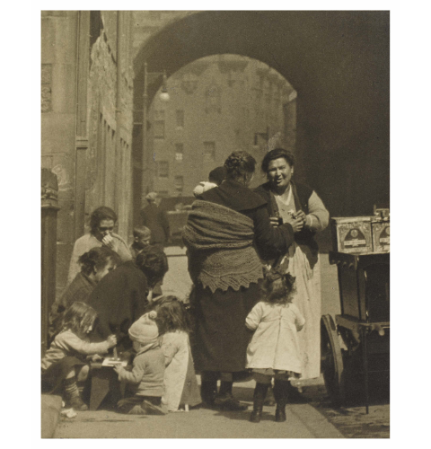
Edinburgh 1923

Slide 61
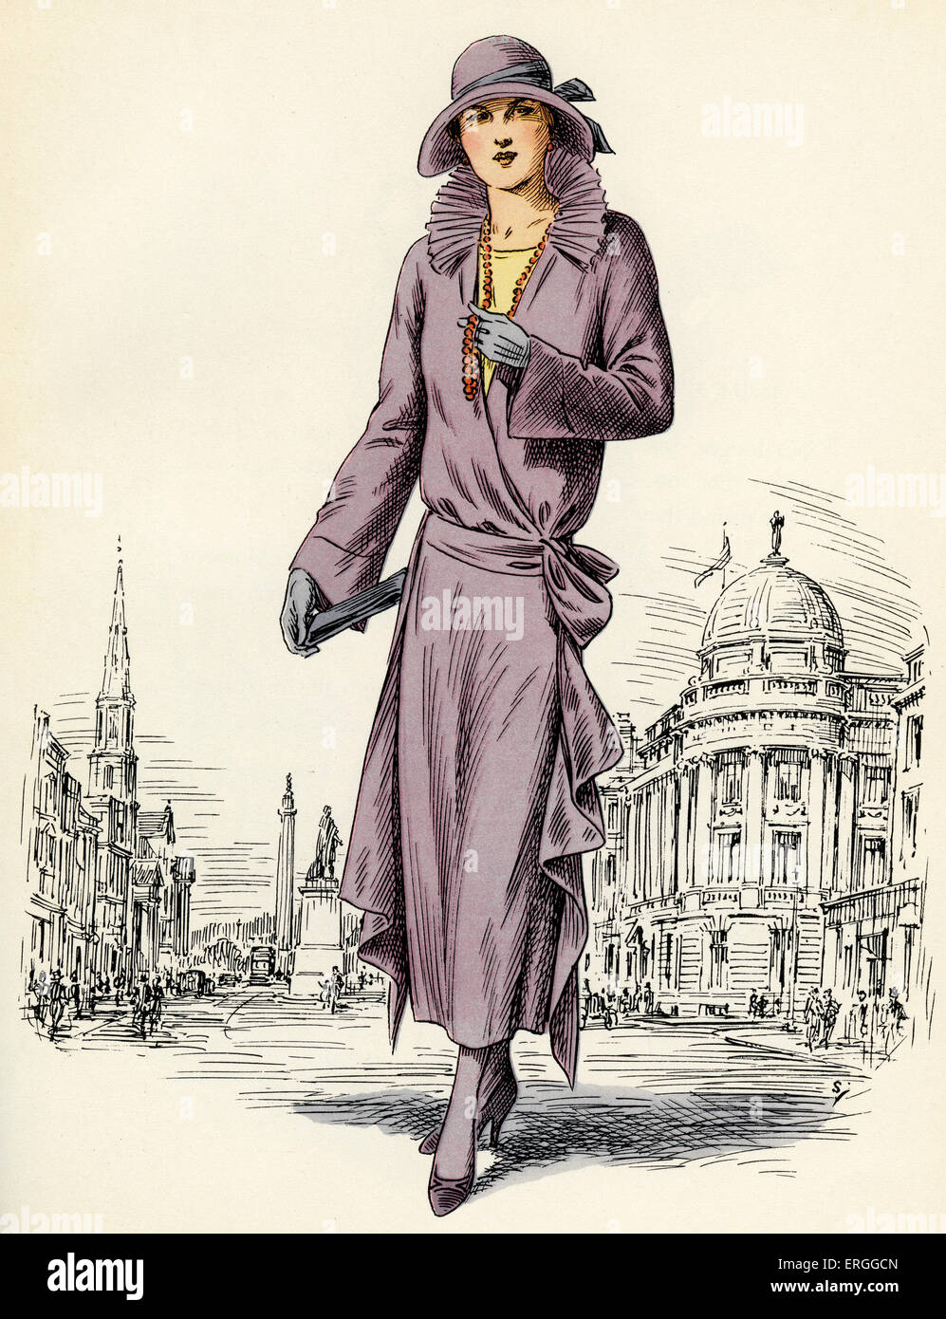
Edinburgh 1923

Slide 62
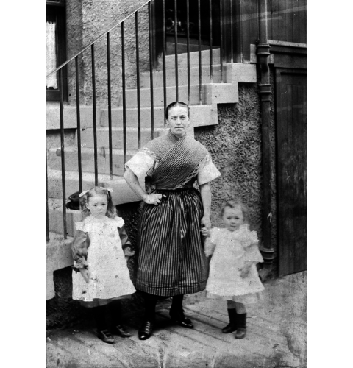
Edinburgh 1923

Slide 63
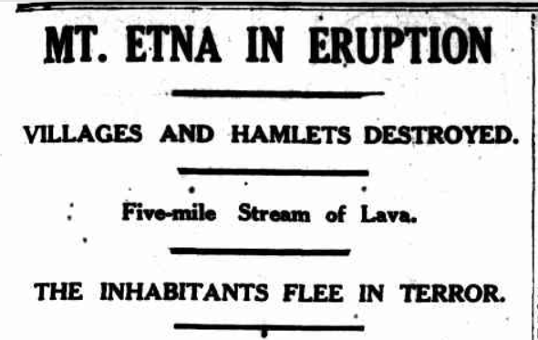
1923
~The Mercury, 20th Jun 1923, Page 7

Slide 64
1923
In Italy, Mount Etna erupted, displacing 60,000 people
~The Mercury, 20th Jun 1923, Page 7

Slide 65
1923
In Italy, Mount Etna erupted, displacing 60,000 people
The Treaty of Lausanne, settling the boundaries of the modern Republic of Turkey, was signed in Switzerland bringing an end to the Ottoman Empire after 624 years
~The Mercury, 20th Jun 1923, Page 7

Slide 66
1923
The Irish Free State joined the League of Nations

Slide 67
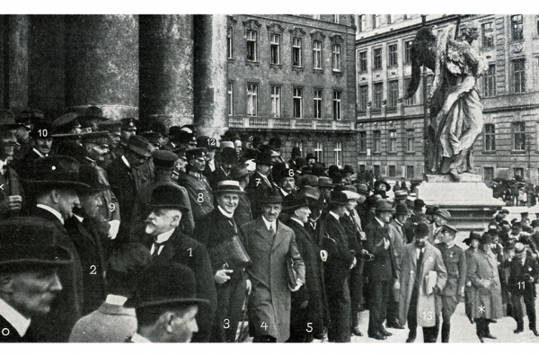
1923
The Irish Free State joined the League of Nations
~ Participants at the International Criminal Police Congress, 1923

Slide 68
1923
The Irish Free State joined the League of Nations
At the International Police Conference in Vienna, the International Criminal Police Commission, better known as INTERPOL, was officially created
~ Participants at the International Criminal Police Congress, 1923

Slide 69
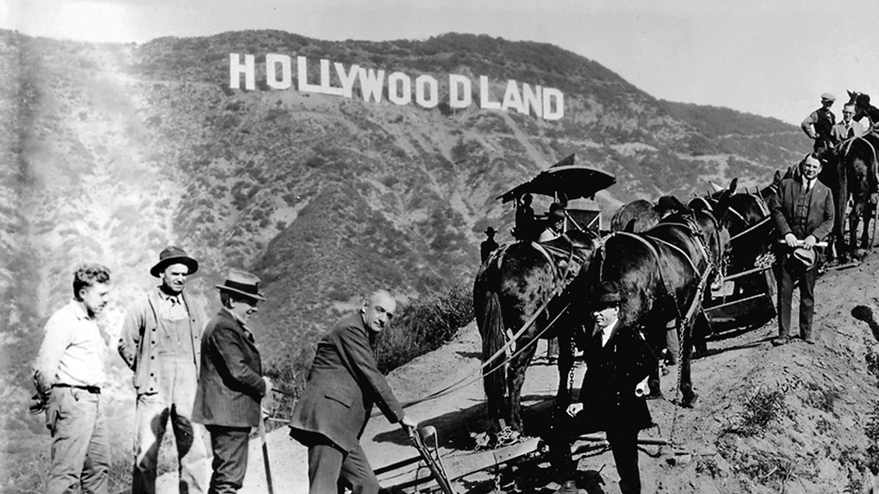
1923

Slide 70
1923
The Hollywood sign was first erected as a billboard for a residential development, named “Hollywoodland”

Slide 71
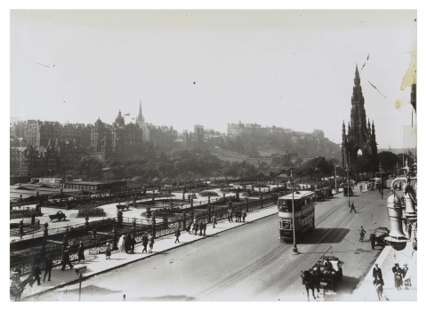
Edinburgh 1923

Slide 72
Edinburgh 1923
Until 1923, passengers travelling from Edinburgh to Leith had to change trams ~ from the cable-drawn carts of the city centre to the electric carts of Leith. This confusion was colloquially known as “the Pilrig muddle”.

Slide 73
Edinburgh 1923
Until 1923, passengers travelling from Edinburgh to Leith had to change trams ~ from the cable-drawn carts of the city centre to the electric carts of Leith. This confusion was colloquially known as “the Pilrig muddle”.
In 1922 Edinburgh caught up with Leith and converted the entire system to electric traction. However, this took time to implement.
The last cable tram took its journey in June 1923

Slide 74
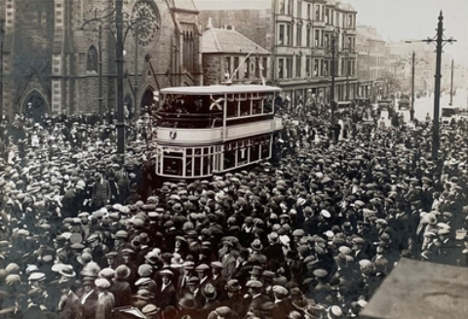
Edinburgh 1923
Until 1923, passengers travelling from Edinburgh to Leith had to change trams ~ from the cable-drawn carts of the city centre to the electric carts of Leith. This confusion was colloquially known as “the Pilrig muddle”.
In 1922 Edinburgh caught up with Leith and converted the entire system to electric traction. However, this took time to implement.
The last cable tram took its journey in June 1923

Slide 75
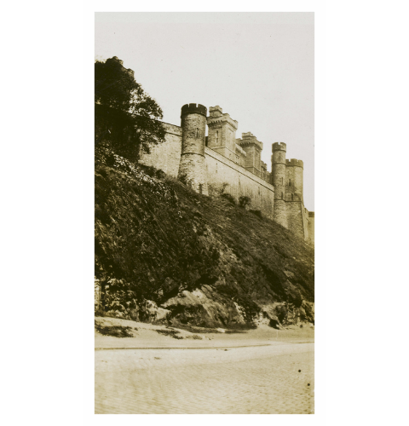
Edinburgh 1923

Slide 76
Edinburgh 1923
The last hanging at the Calton Prison took place in 1923.
Executions continued at Saughton Prison until 1954

Slide 77
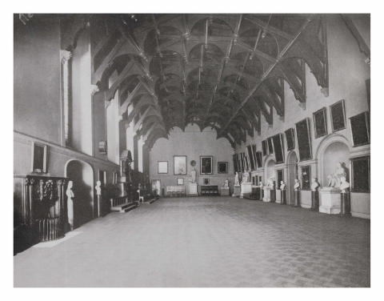
Edinburgh 1923

Slide 78
Edinburgh 1923
Secretary for Scotland and Keeper of the Great Seal: Viscount Novar

Slide 79
Edinburgh 1923
Secretary for Scotland and Keeper of the Great Seal: Viscount Novar
Law Officers:
Lord Advocate: William Watson

Slide 80
Edinburgh 1923
Secretary for Scotland and Keeper of the Great Seal: Viscount Novar
Law Officers:
Lord Advocate: William Watson
Solicitor General for Scotland: David Fleming; then Frederick Thomson

Slide 81
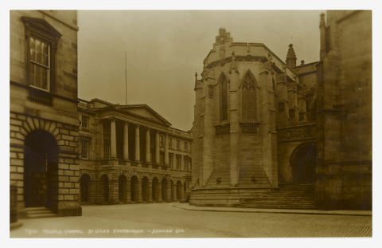
Edinburgh 1923

Slide 82
Edinburgh 1923
The Judiciary:
Lord President of the Court of Session and Lord Justice General: Lord Clyde

Slide 83
Edinburgh 1923
The Judiciary:
Lord President of the Court of Session and Lord Justice General: Lord Clyde
Lord Justice Clerk: Lord Alness

Slide 84
Edinburgh 1923
The Judiciary:
Lord President of the Court of Session and Lord Justice General: Lord Clyde
Lord Justice Clerk: Lord Alness
Chairman of the Scottish Land Court: Lord St Vigeans

Slide 85
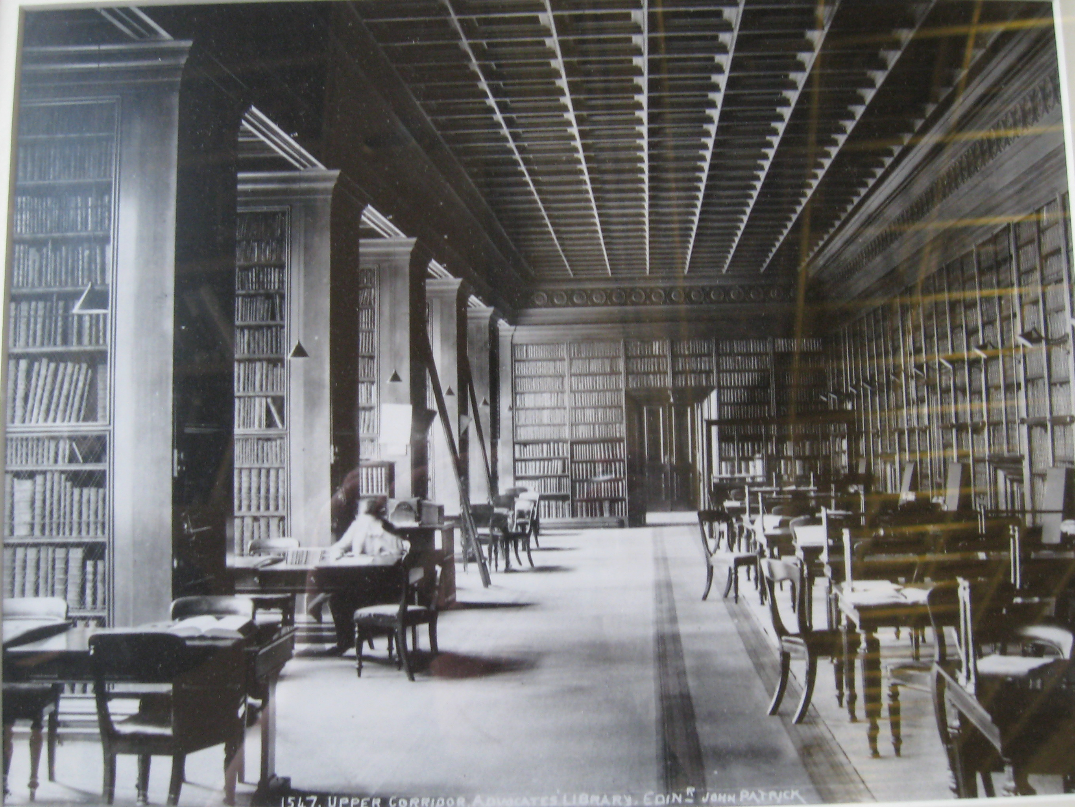
Faculty of Advocates 1923

Slide 86
Faculty of Advocates 1923
Dean of Faculty: Condie Sandeman K.C.

Slide 87
Faculty of Advocates 1923
Dean of Faculty: Condie Sandeman K.C. Keeper of the Advocates Library: William Kirk Dickson

Slide 88
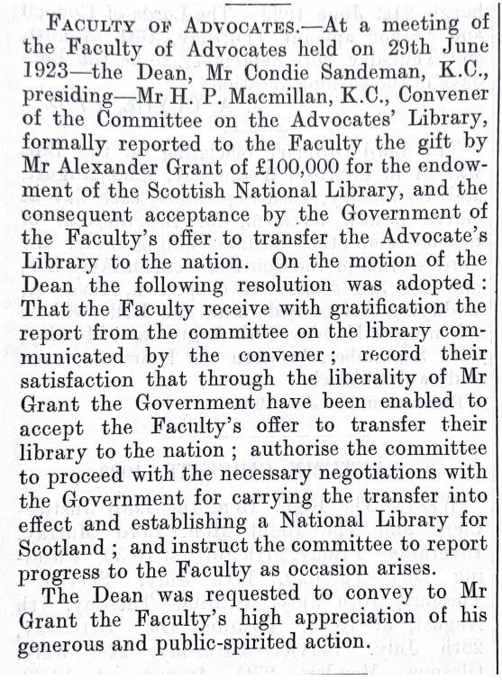
Faculty of Advocates 1923
1923 SLT (News) 100 ~

Slide 89
Faculty of Advocates 1923
By 1923 the Advocates Library held around 725,000 books and pamphlets.
1923 SLT (News) 100 ~

Slide 90
Faculty of Advocates 1923
By 1923 the Advocates Library held around 725,000 books and pamphlets. On 29th June 1923, the Faculty’s donation of its non-legal materials was accepted.
1923 SLT (News) 100 ~

Slide 91
Faculty of Advocates 1923
By 1923 the Advocates Library held around 725,000 books and pamphlets. On 29th June 1923, the Faculty’s donation of its non-legal materials was accepted.
The National Library of Scotland was founded in 1925 and a building to house the collection replaced the former Sheriff Court House on George IV Bridge
1923 SLT (News) 100 ~

Slide 92
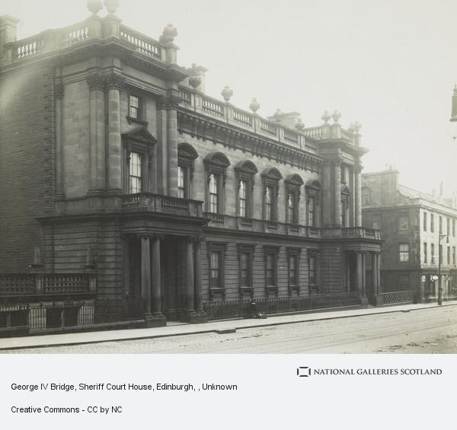
Faculty of Advocates 1923
By 1923 the Advocates Library held around 725,000 books and pamphlets. On 29th June 1923, the Faculty’s donation of its non-legal materials was accepted.
The National Library of Scotland was founded in 1925 and a building to house the collection replaced the former Sheriff Court House on George IV Bridge

Slide 93
Sources and citations
Scottish women 's fashion: 1922. Illustration with George Street, Edinburgh, c. 1920 in background. c. 1936. www.alamy.com
National Galleries: www.nationalgalleries.org
Capital Collections: www.capitalcollections.org.uk
www.onthisday.com/photos/hollywoodland
Trove: https://trove.nla.gov.au
The Mercury, 20th Jun 1923, Page 7
Margaret Kidd Centenary ~ 1923 to 2023

Slide 94
Proceeds and donations from this evening will go to support:
The Lawscot Foundation aims to support academically talented students from less-advantaged backgrounds in Scotland through their legal education journey.
www.lawscotfoundation.org.uk
Womankind Worldwide strengthens and supports women’s rights organisations and movements with the resources they need to challenge oppression and change the lives of women, in the home, the workplace and the communities they live in.
www.womankind.org.uk

Slide 95
Margaret Kidd Centenary ~ 1923 to 2023

